Slide 1
CPR E 281: Digital Logic
Md Maruf Ahamed
Office: 307 Durham Center
Phone: (515) 294-6323
Email: maruf@iastate.edu

Slide 2
29-Moore and Mealy Machines
  Synchronous Sequential Circuits
    Moore Machine
    Mealy Machine
  Designing a Mealy Machine

Slide 3
Administrative Stuff
  Homework: HW#9 due on Sunday @ 11:59 PM
  Quiz: Quiz #10 due on Friday @ 4:25 PM
  Recitation: Recitation 10 next week
  Lab: Lab 10 next week
  Lecture-30 Readings: 6.5 and 6.8

Slide 4
(i) Moore Type
W
Combinational
Q(t+1)
Q(t)
Combinational
Flip-flops
circuit
Z
circuit
Q
Clock
(ii) Mealy Type
W
Combinational
Q(t+1)
Q(t)
Combinational
Flip-flops
circuit
Z
circuit
Q
Clock

Slide 5
Second Design Pattern:
Mealy Machines
W
Combinational
Q(t+1)
Q(t)
Combinational
Flip-flops
circuit
Z
circuit
Q
Clock

Slide 6
Moore & Mealy Machines
Readings 6.3, 6.4

Slide 7

Summary: Designing a Mealy Machine
Obtain the circuit specification
Derive a state diagram
Derive the state table
Decide on a state encoding
Encode the state table
Derive the output logic and next-state logic
Draw the Circuit Diagram
Add a reset signal

Slide 8
Sample Problem
Implement a 11 detector. In other words, the output should be equal to 1 if two consecutive 1’s have been detected on the input line.
The output should become 1 as soon as the second 1 is detected on the input line.

Slide 9
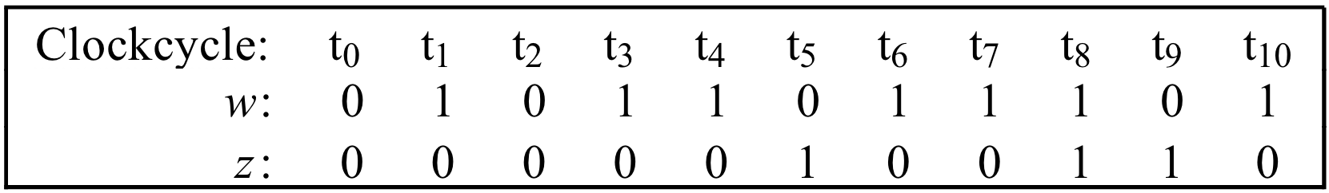
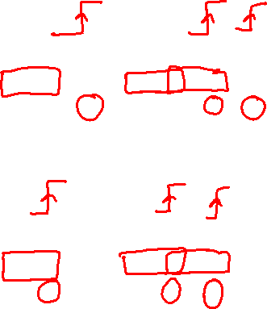
Sequences of input and output signals
Moore type
input
output
Mealy type
Clock cycle:
t
0
t
1
t
2
t
3
t
4
t
5
t
6
t
7
t
8
t
9
t
10
input
w
:
0
1
0
1
1
0
1
1
1
0
1
output
z
:
0
0
0
0
1
0
0
1
1
0
0
The specification requires that the output z be equal to 1 in the clock cycle that follows the detection of the second occurrence of w = 1
[ Figure 6.22 from the textbook ]

Slide 10
Sequences of input and output signals
Clock cycle:
t
0
t
1
t
2
t
3
t
4
t
5
t
6
t
7
t
8
t
9
t
10
input
w
:
0
1
0
1
1
0
1
1
1
0
1
output
z
:
0
0
0
0
1
0
0
1
1
0
0
[ Figure 6.22 from the textbook ]

Slide 11
Sequences of input and output signals
Clock cycle:
t
0
t
1
t
2
t
3
t
4
t
5
t
6
t
7
t
8
t
9
t
10
input
w
:
0
1
0
1
1
0
1
1
1
0
1
output
z
:
0
0
0
0
1
0
0
1
1
0
0
[ Figure 6.22 from the textbook ]

Slide 12
Sequences of input and output signals
Clock cycle:
t
0
t
1
t
2
t
3
t
4
t
5
t
6
t
7
t
8
t
9
t
10
input
w
:
0
1
0
1
1
0
1
1
1
0
1
output
z
:
0
0
0
0
1
0
0
1
1
0
0
[ Figure 6.22 from the textbook ]

Slide 13
Sequences of input and output signals
Clock cycle:
t
0
t
1
t
2
t
3
t
4
t
5
t
6
t
7
t
8
t
9
t
10
input
w
:
0
1
0
1
1
0
1
1
1
0
1
output
z
:
0
0
0
0
1
0
0
1
1
0
0
[ Figure 6.22 from the textbook ]

Slide 14
Sequences of input and output signals
Clock cycle:
t
0
t
1
t
2
t
3
t
4
t
5
t
6
t
7
t
8
t
9
t
10
input
w
:
0
1
0
1
1
0
1
1
1
0
1
output
z
:
0
0
0
0
1
0
0
1
1
0
0
[ Figure 6.22 from the textbook ]

Slide 15
Sequences of input and output signals
Clock cycle:
t
0
t
1
t
2
t
3
t
4
t
5
t
6
t
7
t
8
t
9
t
10
input
w
:
0
1
0
1
1
0
1
1
1
0
1
output
z
:
0
0
0
0
1
0
0
1
1
0
0
[ Figure 6.22 from the textbook ]

Slide 16
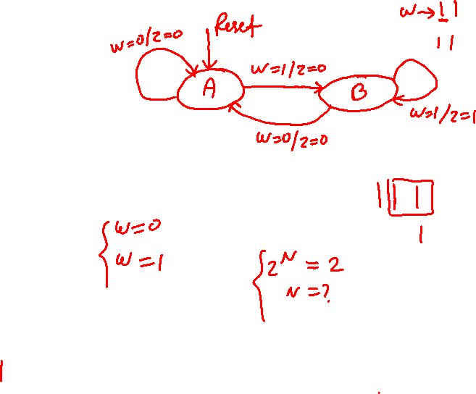
State diagram of an FSM that realizes the task
Moore type
Mealy type
Reset
w
=
1
w
=
0
A: z = 0
B: z = 0
w
=
0
w
=
0
w
=
1
C: z = 1
w
=
1
[ Figure 6.23 from the textbook ]

Slide 17
State diagram of an FSM that realizes the task
Reset
w = 1
z = 0
⁄
w = 0
z = 0
A
B
w = 1
z = 1
⁄
⁄
w = 0
z = 0
⁄
[ Figure 6.23 from the textbook ]

Slide 18
Let’s Do a Simulation
Clock cycle:
t
0
t
1
t
2
t
3
t
4
t
5
t
6
t
7
t
8
t
9
t
10
input
w
:
0
1
0
1
1
0
1
1
1
0
1
output
z
:
0
0
0
0
1
0
0
1
1
0
0
Reset
w = 1
z = 0
⁄
w = 0
z = 0
A
B
w = 1
z = 1
⁄
⁄
w = 0
z = 0
⁄

Slide 19
Let’s Do a Simulation
Clock cycle:
t
0
t
1
t
2
t
3
t
4
t
5
t
6
t
7
t
8
t
9
t
10
input
w
:
0
1
0
1
1
0
1
1
1
0
1
output
z
:
0
0
0
0
1
0
0
1
1
0
0
Reset
w = 1
z = 0
⁄
w = 0
z = 0
A
B
w = 1
z = 1
⁄
⁄
w = 0
z = 0
⁄

Slide 20
Let’s Do a Simulation
Clock cycle:
t
0
t
1
t
2
t
3
t
4
t
5
t
6
t
7
t
8
t
9
t
10
input
w
:
0
1
0
1
1
0
1
1
1
0
1
output
z
:
0
0
0
0
1
0
0
1
1
0
0
Reset
w = 1
z = 0
⁄
w = 0
z = 0
A
B
w = 1
z = 1
⁄
⁄
w = 0
z = 0
⁄

Slide 21
Let’s Do a Simulation
Clock cycle:
t
0
t
1
t
2
t
3
t
4
t
5
t
6
t
7
t
8
t
9
t
10
input
w
:
0
1
0
1
1
0
1
1
1
0
1
output
z
:
0
0
0
0
1
0
0
1
1
0
0
Reset
w = 1
z = 0
⁄
w = 0
z = 0
A
B
w = 1
z = 1
⁄
⁄
w = 0
z = 0
⁄

Slide 22
Let’s Do a Simulation
Clock cycle:
t
0
t
1
t
2
t
3
t
4
t
5
t
6
t
7
t
8
t
9
t
10
input
w
:
0
1
0
1
1
0
1
1
1
0
1
output
z
:
0
0
0
0
1
0
0
1
1
0
0
Reset
w = 1
z = 0
⁄
w = 0
z = 0
A
B
w = 1
z = 1
⁄
⁄
w = 0
z = 0
⁄

Slide 23
Let’s Do a Simulation
Clock cycle:
t
0
t
1
t
2
t
3
t
4
t
5
t
6
t
7
t
8
t
9
t
10
input
w
:
0
1
0
1
1
0
1
1
1
0
1
output
z
:
0
0
0
0
1
0
0
1
1
0
0
Reset
w = 1
z = 0
⁄
w = 0
z = 0
A
B
w = 1
z = 1
⁄
⁄
w = 0
z = 0
⁄

Slide 24
Let’s Do a Simulation
Clock cycle:
t
0
t
1
t
2
t
3
t
4
t
5
t
6
t
7
t
8
t
9
t
10
input
w
:
0
1
0
1
1
0
1
1
1
0
1
output
z
:
0
0
0
0
1
0
0
1
1
0
0
Reset
w = 1
z = 0
⁄
w = 0
z = 0
A
B
w = 1
z = 1
⁄
⁄
w = 0
z = 0
⁄

Slide 25
Let’s Do a Simulation
Clock cycle:
t
0
t
1
t
2
t
3
t
4
t
5
t
6
t
7
t
8
t
9
t
10
input
w
:
0
1
0
1
1
0
1
1
1
0
1
output
z
:
0
0
0
0
1
0
0
1
1
0
0
Reset
w = 1
z = 0
⁄
w = 0
z = 0
A
B
w = 1
z = 1
⁄
⁄
w = 0
z = 0
⁄

Slide 26
Let’s Do a Simulation
Clock cycle:
t
0
t
1
t
2
t
3
t
4
t
5
t
6
t
7
t
8
t
9
t
10
input
w
:
0
1
0
1
1
0
1
1
1
0
1
output
z
:
0
0
0
0
1
0
0
1
1
0
0
Reset
w = 1
z = 0
⁄
w = 0
z = 0
A
B
w = 1
z = 1
⁄
⁄
w = 0
z = 0
⁄

Slide 27
Let’s Do a Simulation
Clock cycle:
t
0
t
1
t
2
t
3
t
4
t
5
t
6
t
7
t
8
t
9
t
10
input
w
:
0
1
0
1
1
0
1
1
1
0
1
output
z
:
0
0
0
0
1
0
0
1
1
0
0
Reset
w = 1
z = 0
⁄
w = 0
z = 0
A
B
w = 1
z = 1
⁄
⁄
w = 0
z = 0
⁄

Slide 28
Let’s Do a Simulation
Clock cycle:
t
0
t
1
t
2
t
3
t
4
t
5
t
6
t
7
t
8
t
9
t
10
input
w
:
0
1
0
1
1
0
1
1
1
0
1
output
z
:
0
0
0
0
1
0
0
1
1
0
0
Reset
w = 1
z = 0
⁄
w = 0
z = 0
A
B
w = 1
z = 1
⁄
⁄
w = 0
z = 0
⁄

Slide 29
Let’s Do a Simulation
Clock cycle:
t
0
t
1
t
2
t
3
t
4
t
5
t
6
t
7
t
8
t
9
t
10
input
w
:
0
1
0
1
1
0
1
1
1
0
1
output
z
:
0
0
0
0
1
0
0
1
1
0
0
Reset
w = 1
z = 0
⁄
w = 0
z = 0
A
B
w = 1
z = 1
⁄
⁄
w = 0
z = 0
⁄

Slide 30
Let’s Do a Simulation
Clock cycle:
t
0
t
1
t
2
t
3
t
4
t
5
t
6
t
7
t
8
t
9
t
10
input
w
:
0
1
0
1
1
0
1
1
1
0
1
output
z
:
0
0
0
0
1
0
0
1
1
0
0
Reset
w = 1
z = 0
⁄
w = 0
z = 0
A
B
w = 1
z = 1
⁄
⁄
w = 0
z = 0
⁄

Slide 31
Let’s Do a Simulation
Clock cycle:
t
0
t
1
t
2
t
3
t
4
t
5
t
6
t
7
t
8
t
9
t
10
input
w
:
0
1
0
1
1
0
1
1
1
0
1
output
z
:
0
0
0
0
1
0
0
1
1
0
0
Reset
w = 1
z = 0
⁄
w = 0
z = 0
A
B
w = 1
z = 1
⁄
⁄
w = 0
z = 0
⁄

Slide 32
Let’s Do a Simulation
Clock cycle:
t
0
t
1
t
2
t
3
t
4
t
5
t
6
t
7
t
8
t
9
t
10
input
w
:
0
1
0
1
1
0
1
1
1
0
1
output
z
:
0
0
0
0
1
0
0
1
1
0
0
Reset
w = 1
z = 0
⁄
w = 0
z = 0
A
B
w = 1
z = 1
⁄
⁄
w = 0
z = 0
⁄

Slide 33
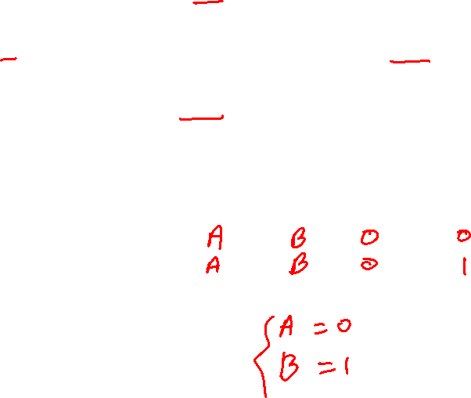
Now Let’s Do the State Table for this FSM
Reset
w
=
1
⁄
z
=
0
w
=
0
⁄
⁄
z
=
0
A
B
w
=
1
z
=
1
w
=
0
⁄
z
=
0
Present
Next state
Output
z
state
w
=
0
w
=
1
w
=
0
w
=
1
A
B

Slide 34
Now Let’s Do the State Table for this FSM
Reset
w
=
1
⁄
z
=
0
w
=
0
⁄
⁄
z
=
0
A
B
w
=
1
z
=
1
w
=
0
⁄
z
=
0
Present
Next state
Output
z
state
w
=
0
w
=
1
w
=
0
w
=
1
A
A
B
0
0
B
A
B
0
1

Slide 35

Let’s Do the State-assigned Table
Present
Next state
Output
z
state
w
=
0
w
=
1
w
=
0
w
=
1
A
A
B
0
0
B
A
B
0
1
Present
Next state
Output
state
w
=
0
w
=
1
w
=
0
w
=
1
y
Y
Y
z
z
A
0
B
1

Slide 36
Let’s Do the State-assigned Table
Present
Next state
Output
z
state
w
=
0
w
=
1
w
=
0
w
=
1
A
A
B
0
0
B
A
B
0
1
Present
Next state
Output
state
w
=
0
w
=
1
w
=
0
w
=
1
y
Y
Y
z
z
A
0
0
1
0
0
B
1
0
1
0
1

Slide 37
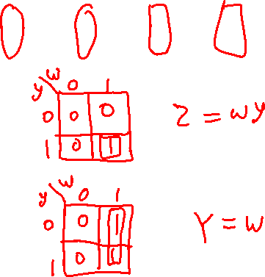
The State-assigned Table
Present
Next state
Output
state
w
=
0
w
=
1
w
=
0
w
=
1
y
Y
Y
z
z
A
0
0
1
0
0
B
1
0
1
0
1
[ Figure 6.25 from the textbook ]

Slide 38
The State-assigned Table
Present
Next state
Output
state
w
=
0
w
=
1
w
=
0
w
=
1
y
Y
Y
z
z
A
0
0
1
0
0
B
1
0
1
0
1
Y = D = w
z = wy
This assumes D flip-flop
[ Figure 6.25 from the textbook ]

Slide 39
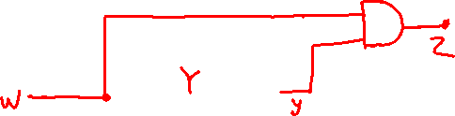
Circuit Implementation of the FSM
D
Q
Clock
Q
Y = D = w
z = wy
[ Figure 6.26 from the textbook ]

Slide 40
Circuit Implementation of the FSM
z
w
D
Q
y
Clock
Q
Resetn
Y = D = w
z = wy
[ Figure 6.26 from the textbook ]

Slide 41

Circuit & Timing Diagram
z
w
D
Q
y
Clock
Q
Resetn
(a) Circuit
t
t
t
t
t
t
t
t
t
t
t
0
1
2
3
4
5
6
7
8
9
10
Clock
1
0
w
1
0
y
1
0
z
1
0
(b) Timing diagram
[ Figure 6.26 from the textbook ]

Slide 42
What if we wanted the output signal to be delayed by 1 clock cycle?

Slide 43
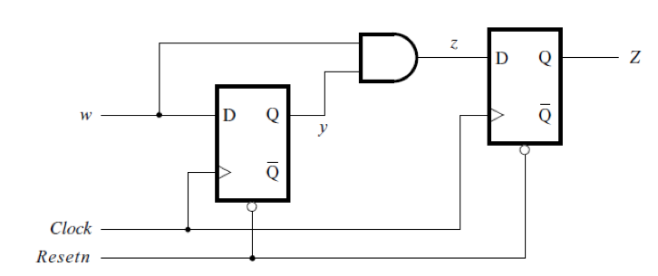
Circuit Implementation of the Modified FSM
[ Figure 6.27a from the textbook ]

Slide 44
Circuit Implementation of the Modified FSM
This flip-flop delays the
output signal by one clock cycle
[ Figure 6.27a from the textbook ]

Slide 45
We Have Seen This Diagram Before
Y
y
Y₁(w, y₂, y₁) = w
2
2
z
D
Q
Y₂(w, y₂, y₁) = wy₁
Q
z(y₂, y₁) = y₂
Y
y
w
1
1
D
Q
Clock
Q
Resetn
[ Figure 6.17 from the textbook ]

Slide 46
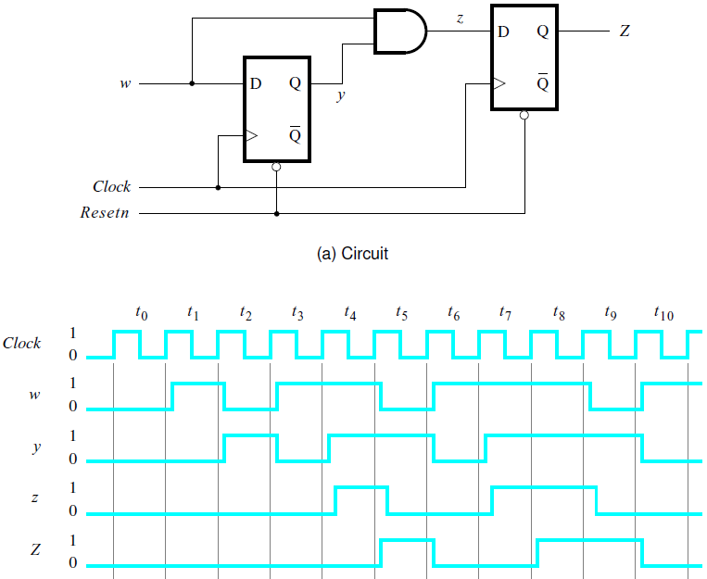

Circuit & Timing Diagram
[ Figure 6.27 from the textbook ]

Slide 47
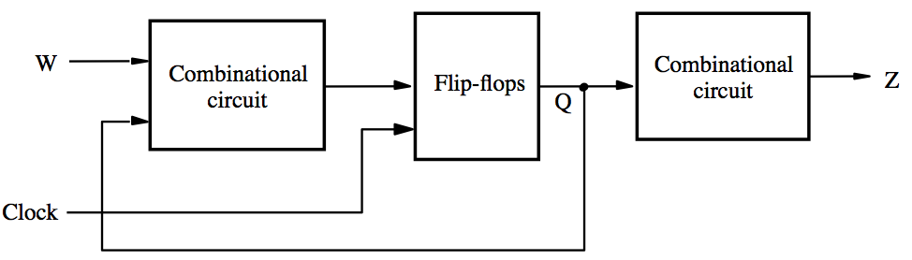
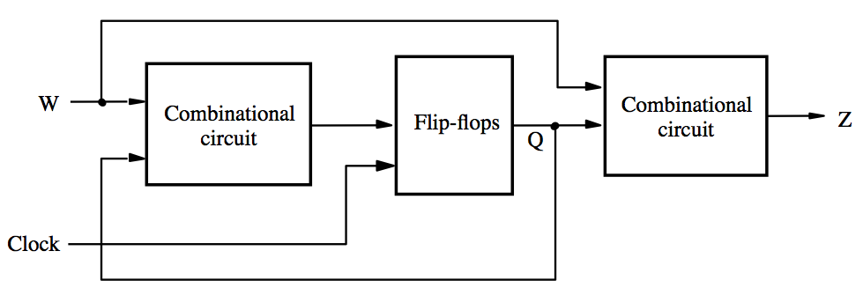
Moore vs Mealy Machine
Moore Mealy

Slide 48
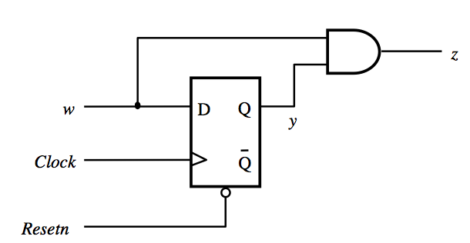
Moore vs Mealy Machine
Moore Mealy

Slide 49
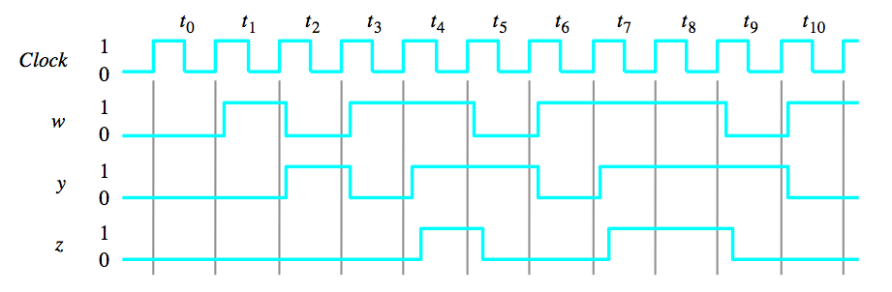
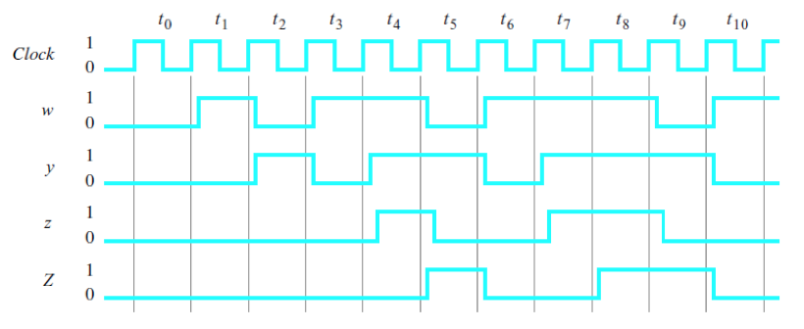
Moore vs Mealy Machine
Mealy
Moore

Slide 50
Notice that the output of the Moore machine is delayed by one clock cycle
Mealy
Moore

Slide 51

Summary: Designing a Mealy Machine
Obtain the circuit specification
Derive a state diagram
Derive the state table
Decide on a state encoding
Encode the state table
Derive the output logic and next-state logic
Draw the Circuit Diagram
Add a reset signal

Slide 52
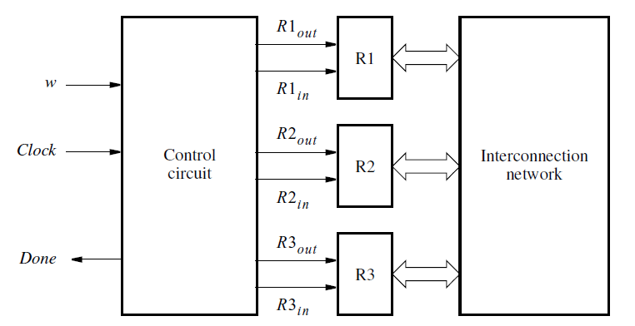

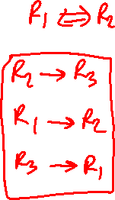
Example #2: Register Swap Controller
Design a Moore machine control circuit for swapping the contents of registers R1 and R2 by using R3 as a temporary.
[ Figure 6.10 from the textbook ]

Slide 53
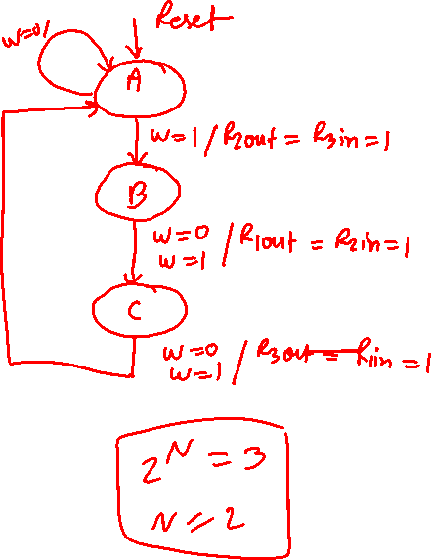
State Diagram
[ Figure 6.11 from the textbook ]

Slide 54
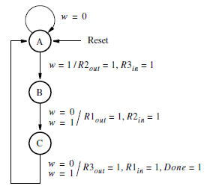
State Diagram
[ Figure 6.28 from the textbook ]

Slide 55
Example 3: Design a Mealy FSM that has one-bit input W and one-bit output Z, where Z=1 if the last three bits of W are 101 (from earliest to latest). Draw the state diagram for this FSM.

Slide 56
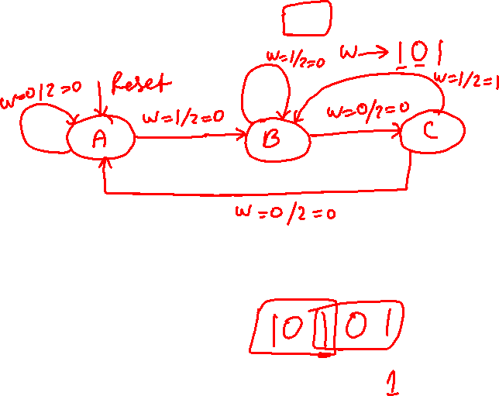
Example 3: Design a Mealy FSM that has one-bit input W and one-bit output Z, where Z=1 if the last three bits of W are 101 (from earliest to latest). Draw the state diagram for this FSM.

Slide 57

END Slide

